Slide 1



Student Project: Seton Hill’s Response to COVID-19
SDT300 Matthew Fluet

Slide 2


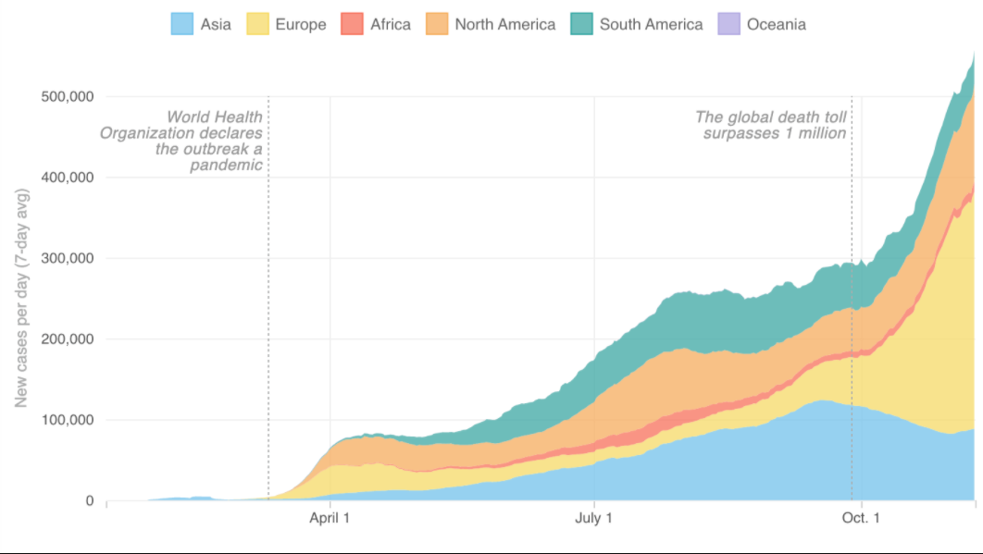
COVID-19
First detection in Wuhan, China in December 2019
large-scale health issue causing millions of deaths around the globe
declared an international pandemic in March 2020 by the World Health Organization (WHO).
September 2020 COVID-19 rose to 6,960,152 cases
Cases spread very quickly
New cases per day (7 day avg)
Notes:
-basic facts about covid (read bullets)
-It spread very quickly (show graph)
-Catching everyone off guard, there was not very many people who were prepared for a pandemic having proper procedures on how to return to normal safely.

Slide 3

Seton Hills choice for in person classes
mandatory to wear a mask while on campus
gathering limit of no more than 10 people when off campus
contact tracing done by the SaferMe app
capacity of classrooms, restrooms and the cafeteria reduced to a fraction of traditional size
Random testing
Student athletes had further regulations due to the constant contact
Notes:
Slide Two
-seton hills Choice to return to traditional in-person classes
-Rules and regulations implemented (Read bullets)
-A ton of schools that made different decisions (Examples of schools in the south big partys Different state rules)

Slide 4
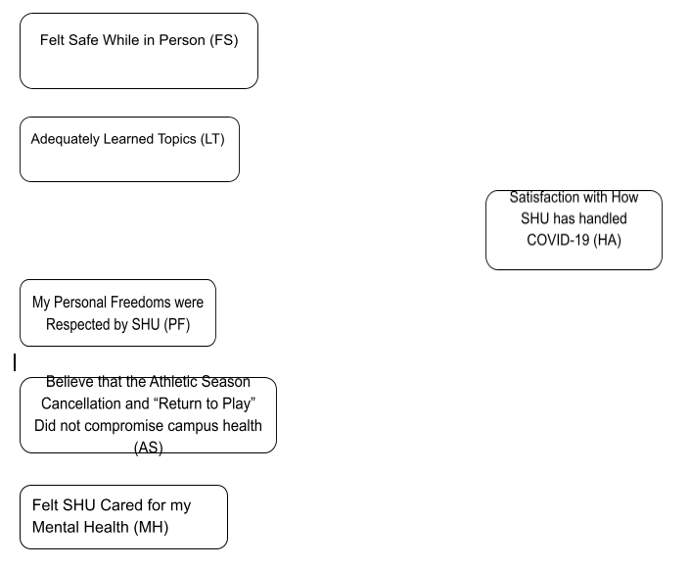
Survey Creation
Created basic model Questions
Remaining questions were categorical to gain insight to why
Approved by Institutional Review Board at Seton Hill
Notes:
Slide Three
-Basic model questions
-ranking from least satisfied to very satisfied with the middle being neutral
-explain IRB process and how it basically took us two full classes to work through just to have them approve it within an hour after submitting

Slide 5
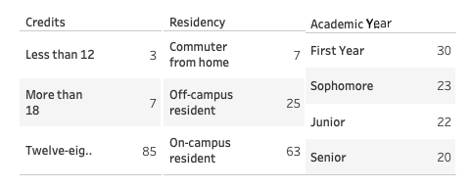
Initial Review of Survey Data
Small sample of the full student body at Seton Hill
majority respond with credits in-between a 12-18 range
majority of students are on-campus residents representing 66 %
off-campus residents and commuters from home to represent the remaining 44%
Notes:
Slide Four
-Explain that we are using a very small sample size approx. 5% of the full student body
-go through the bullet points explaining how it validates data
-explain how we reached out to seton hill for some stats so I could back up my info but never heard back from them

Slide 6


Data recoding
Converted the data from a string variable to an integer
gain descriptive statistics from our survey data
Used the programing language python
Notes:
Slide Five
-Converted data to create a integers making it possible to gain some descriptive statistics
-attempted using PSPP free version of SPSS but was a little wonky so used python instead

Slide 7
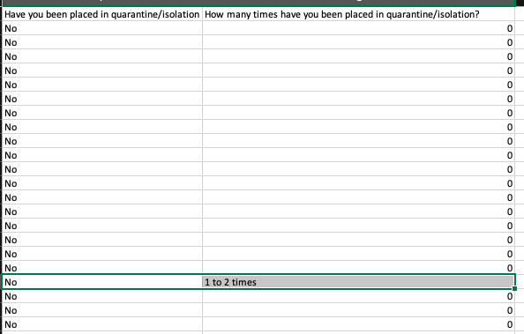
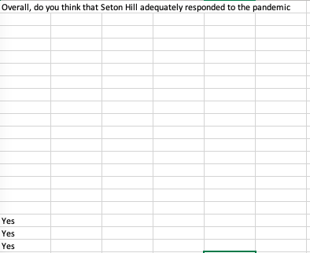
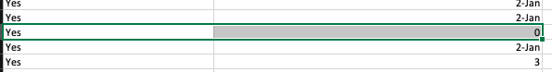
Data Cleaning
2 cases where two attributes contradicted each other
Late addition of Adequate response Question
16 responses were left blank
Notes:
Slide Six
Data cleaning important to keep the data true
-two integrity constraints where columns did not line up
-decided to delete them
-Adequate response question
-how to fix the blanks as I did not want to remove 6 rows of data

Slide 8
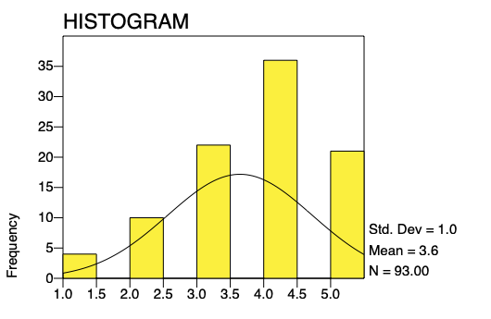
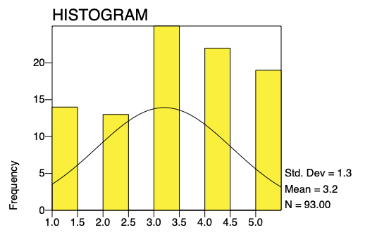
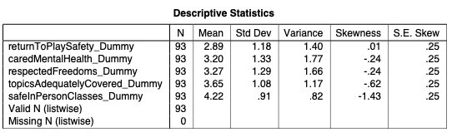
Initial Visuals of Basic Model Questions
Descriptive Stats
Topics were adequately covered in classes
Mental health
-Negative Skewness
-Mean
Notes:
Slide seven
-Descriptive stats using PSPP
-explain the 1-5 scale
-negative skew data leaning to the right which is good
-similar the mean is over the middle point of 3
-Note of the spike in mental health and how I will discuss later

Slide 9
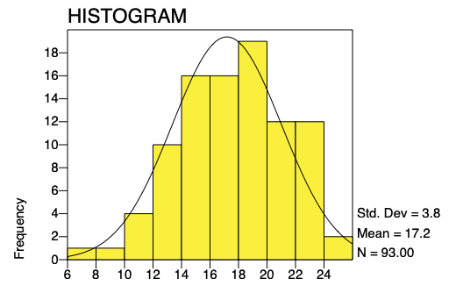
Creation of overall satisfaction score
Use the basic model questions to create an overall experience score for each entity
Range of score 5-25
Showed a normalized distribution
Notes:
Slide eight
-Using the 5 basic model questions create overall satisfaction score to classify each row with a rank
-Showed a great normalized distribution following the curve

Slide 10
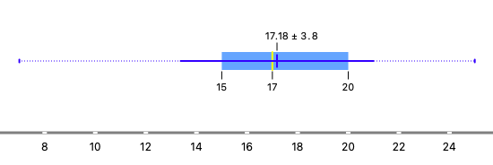
How I adjusted to the adequate response errors
Box plot Overall Satisfaction Scores
mean of 17.18 I will be able to confidently classify if the student would have responded with a yes or no
is not a 100% accurate solution to the missing data problem
better step than completely deleting all the useful data all because of one missing entity in 16 rows.
Notes:
Slide nine
-Fixed the adequate response if the students score was above the mean I considered they would reply yes and vise versa
-not a great way but I felt it was better than deleting 16 rows of data

Slide 11
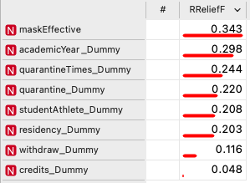
RreliefF
ranking of attributes with the overall satisfaction score as my target.
RreliefF gain insight of conditional dependencies with attributes and give me a value on attribute estimation in classification and regression
open-source machine learning program Orange
Notes:
Slide ten
-R relief F Score
-using orange an open source machine learning program
-used the overall satisfaction score as my target feature to rank all the attributes to decide what is best to use

Slide 12
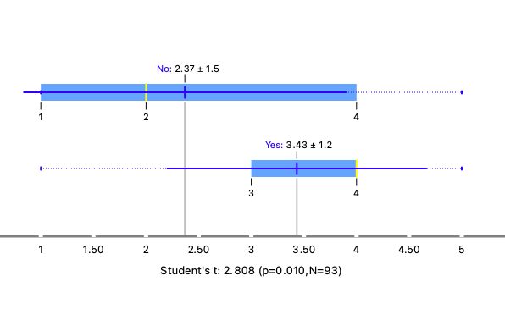
Mask effectiveness vs Adequate Response
-P-Value
Null Hypothesis: Student's belief in mask effectiveness is not associated with Adequate Response.
Alternative: Student's belief in mask effectiveness is associated with Adequate Response.
Conclusion: p<0.05 so reject the Null Hypothesis.
-major difference between the spreads of responses
Notes:
Slide eleven
Mask effectiveness vrs an adequate response
-p value is below a 0.05 so I can reject the null hypothesis
-students who believe masks are effective are more likely to be satisfied with how seton hill handled covid
-Spread

Slide 13
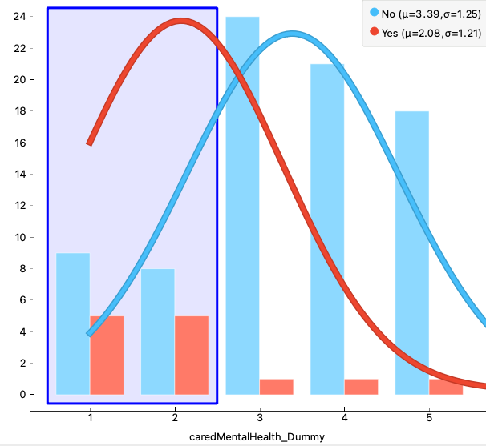
Mental Health distribution vs Consideration of Withdrawal
Associated with consideration of withdrawal from the University
Very dissatisfied and dissatisfied did not follow a normal distribution
Students who considered withdrawal were associated with feeling that Seton Hill did not take proper actions when considering mental health.

Slide 14
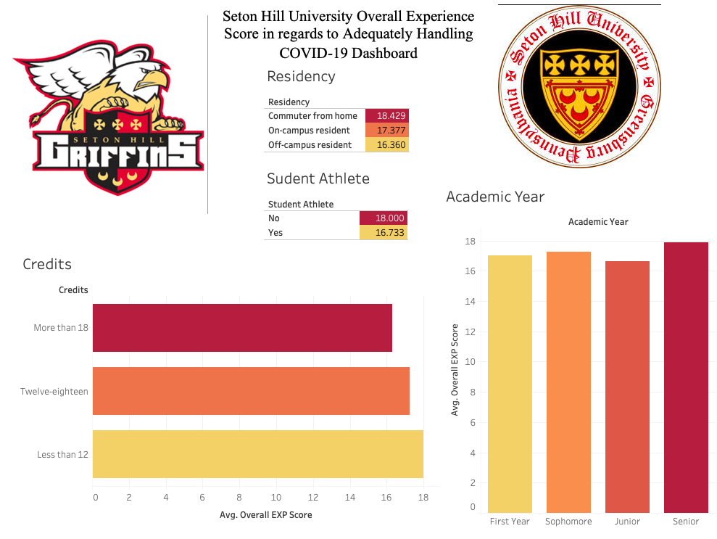
Overall Satisfaction Score Dashboard
Notes:
Slide Thirteen
-Show how basically the data was super clean and that it was hard to find any weird correlations to talk on everything was pretty basic

Slide 15
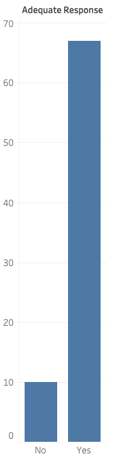

Conclusion
majority of all our main basic model questions showing normalized distribution with negative skews
Overall Satisfaction score had a normalized distribution with a mean of 17.18 above the middle point of 15
Had 79.56% of students straight up say they believe Seton Hill adequately responded to COVID-19
Notes:
Slide Fourteen
Because of this I can confidently say I believe seton hill adequately handled covid

